Slide 1
∫
Calculus for Machine Learning
How rates of change, gradients, and optimization power the algorithms behind modern ML
M.Tech / Data Science Series

Slide 2
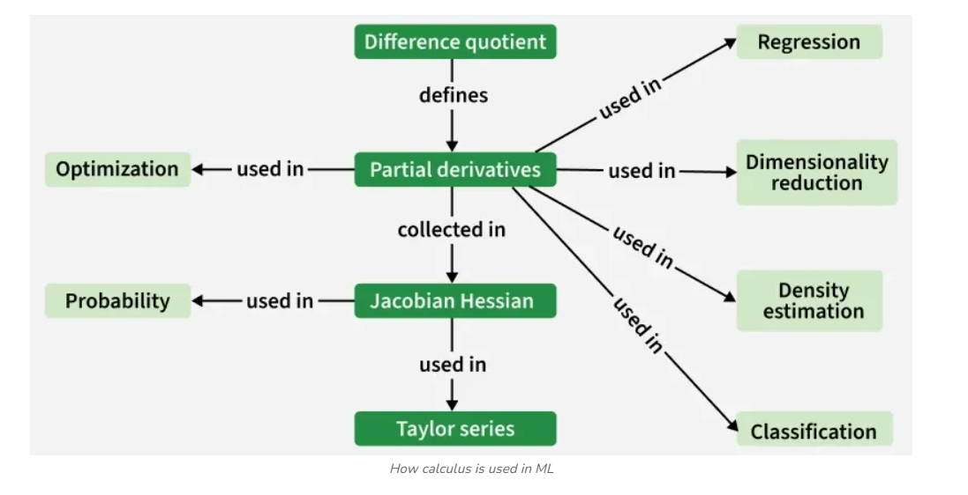
1
Introduction
Calculus is a key tool in developing machine learning algorithms and models. It offers a mathematical framework for describing how machines learn and optimize their performance. It allows practitioners to analyze and improve the learning process by modeling changes in system behavior.
The derivative describes the slope of a function at a point — the foundation of every optimization method in ML.
Core idea: Machine learning is fundamentally an optimization problem — and calculus is the language of change and optimization.
Calculus for Machine Learning
2

Slide 3
2
Why Is Calculus Important in Machine Learning
Calculus is important because it enables:
1
2
3
Optimization
Understanding Algorithms
Function Approximation
Used in algorithms like gradient descent to minimize or maximize cost functions.
Helps explain how algorithms work internally, such as backpropagation in neural networks.
Used when exact solutions aren't possible, to approximate functions mathematically.
Calculus for Machine Learning
3

Slide 4
Fundamental Calculus Concepts for Machine Learning
1
Differentiation
Measures how a function's output changes with respect to its input
2
Partial Derivatives
Extends differentiation to functions of multiple variables
3
Gradient & Gradient Descent
A vector of partial derivatives used to find a function's minimum
4
Chain Rule
Computes the derivative of composite functions
5
Jacobian & Hessian Matrices
First- and second-order partial derivatives in matrix form

Slide 5
1
Differentiation
Differentiation measures how a function's output changes with respect to its input. In machine learning, it is used to:
numerical_derivative.py
import numpy as np
def f(x):
return x**3 + 2*x**2 + 1
def derivative(f, x, h=1e-5):
return (f(x + h) - f(x - h)) / (2*h)
x0 = 2.0
slope = derivative(f, x0)
print(f'Slope at x={x0}: {slope:.4f}')
# Slope at x=2.0: 20.0000
# Gradient descent step using the derivative
lr = 0.01
x0 = x0 - lr * derivative(f, x0)
Calculate gradients in gradient descent
Optimize cost functions
Understand how small input changes affect predictions
differentiation.py
import sympy as sp
x = sp.Symbol('x')
f = x**3 + 2*x**2 + 1
df_dx = sp.diff(f, x)
print(df_dx) # 3*x**2 + 4*x
Calculus for Machine Learning
5

Slide 6
2
Partial Derivatives
Partial derivatives extend differentiation to functions of multiple variables, measuring how the function changes as one variable changes while others stay constant. They are important in:
partial_derivatives.py
import sympy as sp
x, y = sp.symbols('x y')
f = x**2 * y + sp.sin(y) * x
df_dx = sp.diff(f, x)
df_dy = sp.diff(f, y)
print('df/dx =', df_dx)
print('df/dy =', df_dy)
# df/dx = 2*x*y + sin(y)
# df/dy = x**2 + x*cos(y)
# Gradient vector at a point
grad = sp.Matrix([df_dx, df_dy])
print(grad.subs({x: 1, y: 0}))
Multivariable optimization problems
Training models with multiple parameters (like neural networks)
Notation
For f(x, y): ∂f/∂x holds y constant, ∂f/∂y holds x constant.
Together they form the gradient vector ∇f = [∂f/∂x, ∂f/∂y].
Calculus for Machine Learning
6

Slide 7
3
Gradient and Gradient Descent
The gradient is a vector of partial derivatives showing the direction of the steepest ascent of a function. Gradient descent uses this gradient to find the function's minimum by:
gradient_descent.py
import numpy as np
# Cost function: J(theta) = (theta - 3)^2
def cost(theta):
return (theta - 3) ** 2
def gradient(theta):
return 2 * (theta - 3)
theta = 0.0
lr = 0.1
for step in range(20):
grad = gradient(theta)
theta = theta - lr * grad
if step % 5 == 0:
print(f'step {step}: theta={theta:.3f}, J={cost(theta):.3f}')
print('Converged theta:', round(theta, 3)) # ~3.0
Adjusting model parameters in the opposite direction of the gradient
Iteratively minimizing the cost function during training
Update rule
θ_new = θ_old − α · ∇J(θ)
where α is the learning rate and ∇J(θ) is the gradient of the cost function.
Calculus for Machine Learning
7

Slide 8
4
Chain Rule
The chain rule computes the derivative of composite functions. It is essential in: The chain rule is a way to find the derivative of composite functions. It allows us to differentiate complex expressions by differentiating the outer function and then multiplying by the derivative of the inner function.
chain_rule.py
import sympy as sp
x = sp.Symbol('x')
g = 2*x + 1 # inner function
f = sp.sin(g) # outer function
dfdx = sp.diff(f, x) # chain rule applied
print(dfdx) # 2*cos(2*x + 1)
# Manual chain rule for a tiny 2-layer network
def sigmoid(z): return 1 / (1 + np.exp(-z))
import numpy as np
w, x_in, b = 0.5, 2.0, 0.1
z = w * x_in + b
a = sigmoid(z)
# dL/dw = dL/da * da/dz * dz/dw
da_dz = a * (1 - a)
dz_dw = x_in
dL_dw = 1.0 * da_dz * dz_dw # chained gradient
Backpropagation, where derivatives are chained through layers
Calculating gradients efficiently in deep learning models
Rule
If y = f(g(x)), then:
dy/dx = f'(g(x)) · g'(x)
In a neural network, this chains layer-by-layer to compute how the loss changes with respect to every weight.
Calculus for Machine Learning
8

Slide 9
Applications:
This chain rule is widely used in mathematics to find the differentiation of complex functions. Some of its uses are discussed below,
For finding the rate of change of the pressure with respect to time.
For finding the rate of change of the average molecular speed.
To determine if the given function is increasing or decreasing.
For finding the rate of change of distance between two moving objects,

Slide 10
5
Jacobian and Hessian Matrices
Jacobian Matrix
jacobian_hessian.py
J
import sympy as sp
x, y = sp.symbols('x y')
# Vector-valued function -> Jacobian
F = sp.Matrix([x**2 + y, sp.sin(x) * y])
J = F.jacobian([x, y])
print('Jacobian:'); print(J)
# Scalar function -> Hessian
f = x**2 * y + y**3
H = sp.hessian(f, (x, y))
print('Hessian:'); print(H)
# Newton's method update direction
# theta_new = theta - H_inv @ gradient
Contains all first-order partial derivatives of a vector-valued function.
H
Hessian Matrix
Contains all second-order partial derivatives of a scalar-valued function.
Used in: analyzing curvature of cost functions and implementing advanced optimization techniques like Newton's method.
Calculus for Machine Learning
9

Slide 11
λ
Applying Calculus in Machine Learning Algorithms
Linear Regression · Logistic Regression · Neural Networks · Support Vector Machines

Slide 12

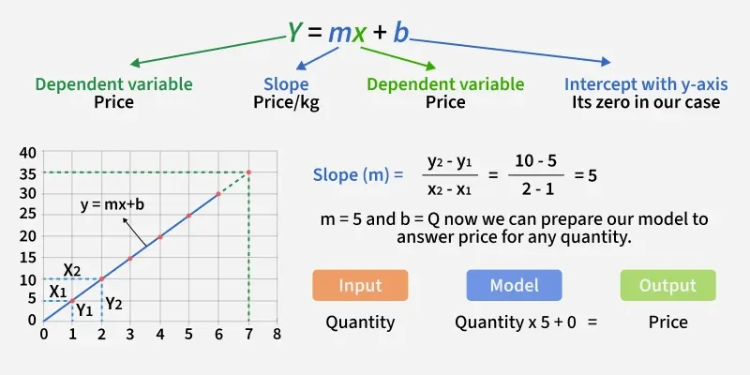
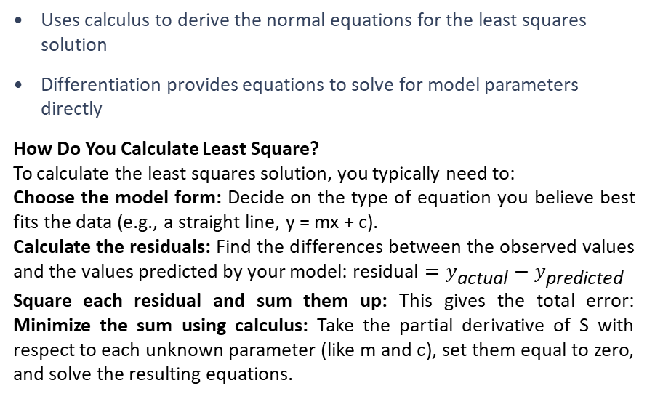
Linear Regression
1
linear_regression.py
import numpy as np
from sklearn.linear_model import LinearRegression
X = np.array([[1], [2], [3], [4], [5]])
y = np.array([2, 4, 5, 4, 5])
model = LinearRegression()
model.fit(X, y)
print('Slope:', model.coef_[0])
print('Intercept:', model.intercept_)
# Normal equation derived via calculus:
# theta = (X^T X)^-1 X^T y
Xb = np.c_[np.ones((5, 1)), X]
theta = np.linalg.inv(Xb.T @ Xb) @ Xb.T @ y
print('theta (closed form):', theta)
Uses calculus to derive the normal equations for the least squares solution
Differentiation provides equations to solve for model parameters directly
How Do You Calculate Least Square?
To calculate the least squares solution, you typically need to:
Choose the model form: Decide on the type of equation you believe best fits the data (e.g., a straight line, y = mx + c).
Calculate the residuals: Find the differences between the observed values and the values predicted by your model: $\text{residual}=y_{\text{actual}}−y_{\text{predicted}}$
Square each residual and sum them up: This gives the total error: Minimize the sum using calculus: Take the partial derivative of S with respect to each unknown parameter (like m and c), set them equal to zero, and solve the resulting equations.
Calculus for Machine Learning
11

Slide 13
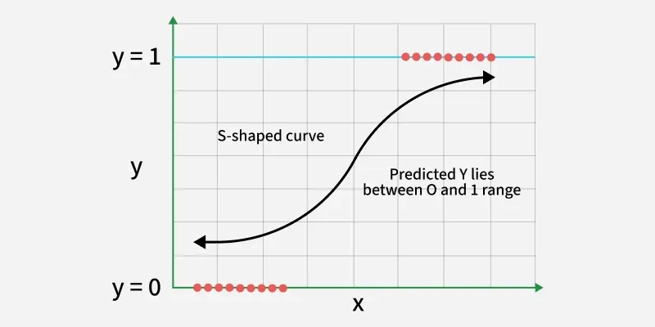
2
Logistic Regression
logistic_regression.py
import numpy as np
from sklearn.linear_model import LogisticRegression
X = np.array([[1], [2], [3], [4], [5], [6]])
y = np.array([0, 0, 0, 1, 1, 1])
model = LogisticRegression()
model.fit(X, y)
print('Predicted probs:', model.predict_proba(X)[:, 1])
# Sigmoid + gradient of log-loss
def sigmoid(z): return 1 / (1 + np.exp(-z))
def grad_log_loss(w, b, X, y):
z = X @ w + b
pred = sigmoid(z)
dw = X.T @ (pred - y) / len(y) # d(loss)/dw
db = np.mean(pred - y) # d(loss)/db
return dw, db
Uses the sigmoid function to model probabilities for binary outcomes
The cost function (log-loss) is minimized using gradient descent, which relies on derivatives
Gradients of the cost function guide parameter updates during training
Calculus for Machine Learning
12

Slide 14
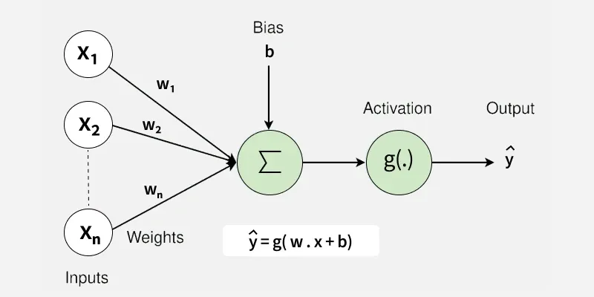
3
Neural Networks
backpropagation.py
import numpy as np
def sigmoid(z): return 1 / (1 + np.exp(-z))
def d_sigmoid(a): return a * (1 - a)
# Forward pass (1 hidden layer)
z1 = X @ W1 + b1
a1 = sigmoid(z1)
z2 = a1 @ W2 + b2
a2 = sigmoid(z2) # prediction
# Backward pass -- chain rule through layers
dL_da2 = (a2 - y)
dL_dz2 = dL_da2 * d_sigmoid(a2)
dL_dW2 = a1.T @ dL_dz2
dL_da1 = dL_dz2 @ W2.T
dL_dz1 = dL_da1 * d_sigmoid(a1)
dL_dW1 = X.T @ dL_dz1
W1 -= lr * dL_dW1; W2 -= lr * dL_dW2
Relies heavily on calculus, especially in the backpropagation algorithm
The chain rule computes the gradient of the loss function with respect to each weight
This allows efficient weight updates during training to reduce the loss function value
Calculus for Machine Learning
13

Slide 15
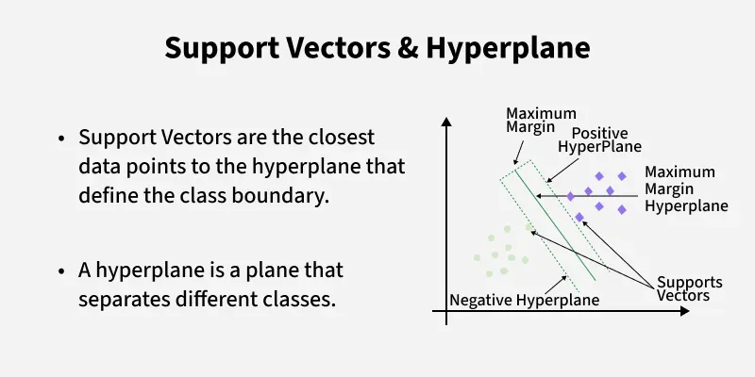
4
Support Vector Machines (SVMs)
svm.py
import numpy as np
from sklearn.svm import SVC
X = np.array([[1, 2], [2, 3], [3, 3], [6, 5], [7, 8]])
y = np.array([0, 0, 0, 1, 1])
model = SVC(kernel='linear', C=1.0)
model.fit(X, y)
print('Support vectors:', model.support_vectors_)
# Lagrangian: L = 1/2||w||^2 - sum(a_i*(y_i(w.x_i+b)-1))
# Setting partial derivatives to zero gives:
# dL/dw = 0 -> w = sum(a_i * y_i * x_i)
# dL/db = 0 -> sum(a_i * y_i) = 0
w = model.coef_[0]
margin = 2 / np.linalg.norm(w)
print('Margin width:', margin)
Uses calculus to find the optimal separating hyperplane by maximizing the margin between classes
Solves a constrained optimization problem using Lagrange multipliers (which involve partial derivatives)
The gradient conditions are used to find the points that lie on the margin
Calculus for Machine Learning
14

Slide 16
Key Takeaways
✓
Calculus underlies every optimization step in machine learning — from linear regression to deep neural networks
✓
Differentiation and gradients tell a model which direction to adjust its parameters
✓
The chain rule makes backpropagation possible, chaining derivatives across layers
✓
Jacobian and Hessian matrices enable advanced, curvature-aware optimization methods

